Slide 1
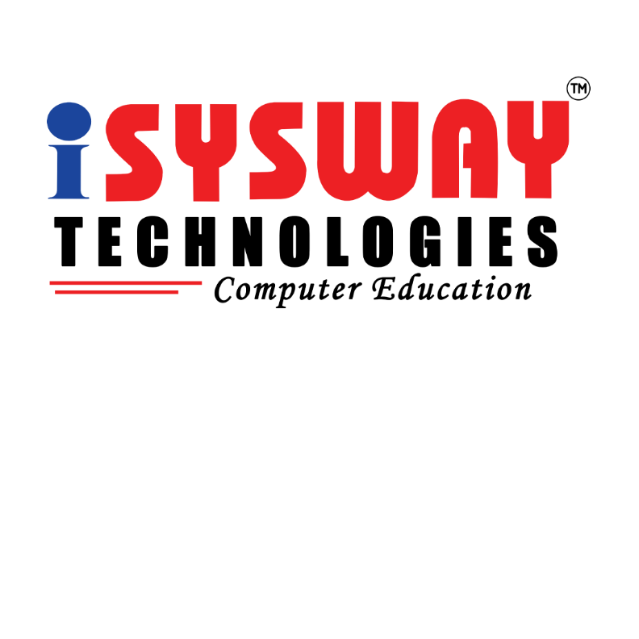
AWS & AZURE
Prepared By
Isysway Technologies

Slide 2
Day-1 Topics
Introduction about Virtualization
Introduction about Cloud Computing
Overview of AWS
History and Evolution of AWS
Overview of AWS Products and Services
Global Infrastructure

Slide 3

Virtualization
Topics Covered
Introduction
Types of Virtualization
VIRTUALIZATION PROCESS
VIRTUAL MACHINE
THE HYPERVISOR
Benefits of Virtualization

Slide 4
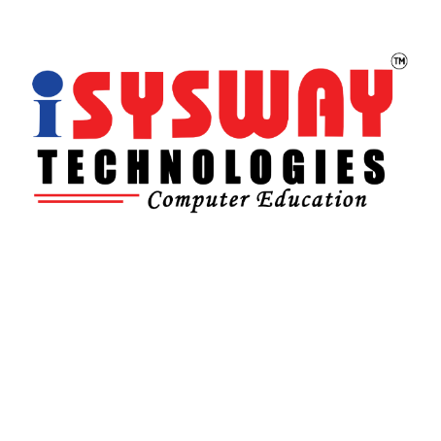
Introduction
Virtualization is the process of simulating a HARWARE & SOFTWARE resource, such as a server, storage device, or network, in a Virtual or software environment.
Importance of virtualization: Virtualization allows for efficient utilization of resources, improved scalability, enhanced flexibility, and cost savings in IT infrastructure.

Slide 5

Types of Virtualization
Server Virtualization: Involves creating multiple virtual servers on a single physical server, allowing for consolidation of servers and efficient resource allocation.
Storage Virtualization: Involves abstracting physical storage devices into virtual storage pools, enabling easier management and utilization of storage resources.
Network Virtualization: Involves creating virtual networks on top of physical networks, providing flexibility and agility in network configurations.

Slide 6
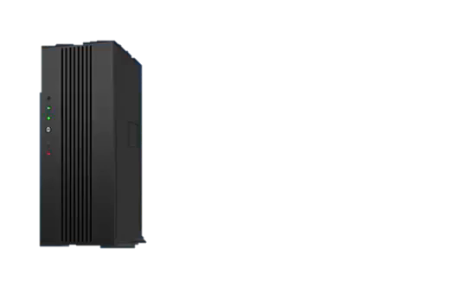
VIRTUALIZATION PROCESS
In traditional way a business operates by having one machine for one application.
For Example.
EMAIL SERVER
RUNS ON
WINDOWS OS
WEB SERVER
RUNS ON
LINUX OS
DATABASE SERVER
RUNS ON
UNIX OS

Slide 7
VIRTUALIZATION PROCESS
But instead of having three servers running one application each. What if just one server could do as good and do it more efficiently.
So basically one server can take place of the three and all the applications and run their different operating systems this is what VIRTUALIZATION does.
Its basically consolidating all of these physical servers with their different OS ,applications and running them on just one physical server in a virtual environment.

Slide 8
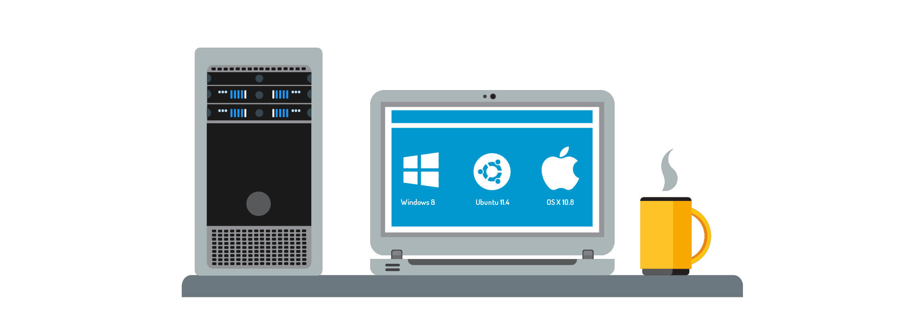
VIRTUAL MACHINE
Virtualization creates virtual hardware by cloning physical hardware.
The hypervisor uses virtual hardware to create a virtual machine (VM).
A VM is a set of files.
With a hypervisor and VMs, one computer can run multiple OS simultaneously.

Slide 9
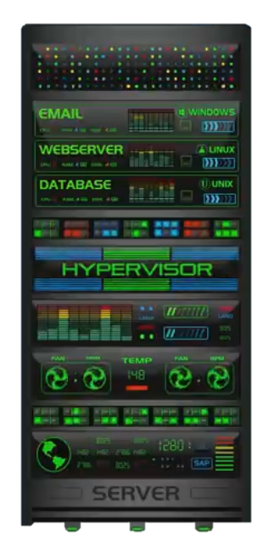
VIRTUALIZATION MACHINE
Its running three different applications such as EMAIL SERVER , WEB SEERVER , DATABASE SERVER. also runs different operating system.
And its doing these all by using software
It does it so well when user interact with virtual server they feel like interact
physical server
This server is running three VIRTUAL MACHINE

Slide 10
THE HYPERVISOR
The software that creates and runs the virtualization is called HYPERVISOR
It allocates and controls the sharing of machine’s resources such as
STORAGE SPACE
RAM
CPU’S
Two types of hypervisors is known as TYPE 1 Hypervisor & TYPE 2 Hypervisor

Slide 11
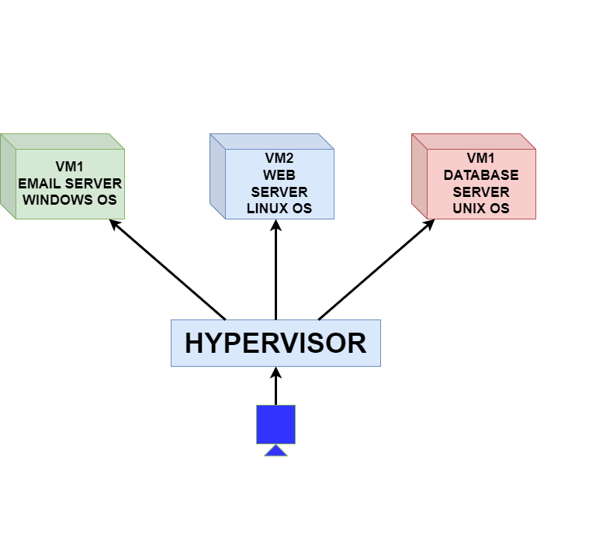
HYPERVISOR
TYPE 1
Type 1 HYPERVISOR installed on
BARE METAL SERVER
That means there is no existing operating system (or) any other
Software on the machine
Used for Hardware virtualization

Slide 12
TYPE 1 HYPERVISOR
In order to create a VM with a Type 1 hypervisor we start out with
SERVER CASE
HARDWARES SUCH AS
MOTHERBARD
CPU
RAM
HARD DISK DRIVES

Slide 13
TYPE 1 HYPERVISOR
After build our server hardware next step is to install type 1 hypervisor on top of ours baremetal server.
So we can create and manage VM’s .
The hypervisor will allocates the server hardware resources, installing different OS and installing different applications.
Mainly used in ENTERPRISE DATACENTER

Slide 14
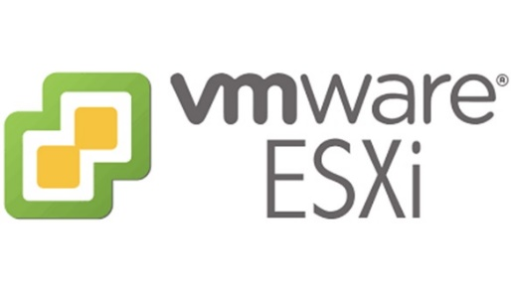
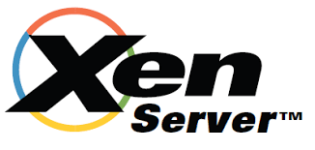
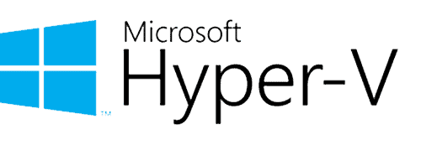
TYPE 1 HYPERVISOR
Some of the examples for type 1 HYPERVISOR
VMWARE ESXI
CITRIX XEN SERVER
MICROSOFT HYPER-V

Slide 15
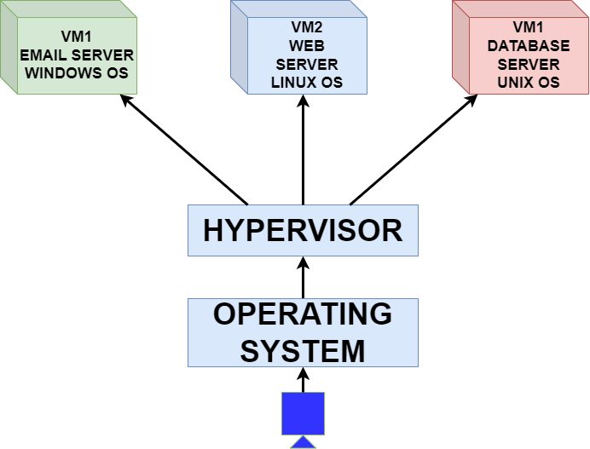
TYPE 2 HYPERVISOR
TYPE 2
Type 1 HYPERVISOR installed and runs on the top of an existing operating system
Mostly used for OS virtualization
Quick and easy

Slide 16
TYPE 2 HYPERVISOR
It’s installed and runs on the top of an operating system
Typically used in personal computers
Mainly used to test new software for research purposes
Try out and test different operating systems.

Slide 17
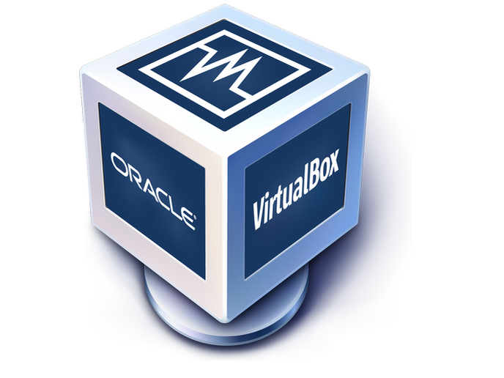
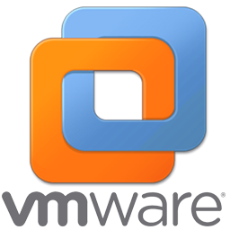

TYPE 2 HYPERVISOR
Oracle VirtualBox
Microsoft Virtual PC
VM workstation

Slide 18

Benefits of Virtualization
Cost Savings: Virtualization reduces hardware costs, data center space, and energy consumption by consolidating resources and improving utilization.
Increased Flexibility: Virtualization enables dynamic allocation of resources, making it easier to scale up or down based on workload demands.
Improved Management: Virtualization simplifies IT management through centralized administration, automation, and easier backup and recovery.
Enhanced Security: Virtualization allows for isolation of virtual machines (VMs), providing improved security and reducing the risk of data breaches.
Business Continuity: Virtualization enables disaster recovery and business continuity by facilitating VM migration and replication to other physical hosts.

Slide 19
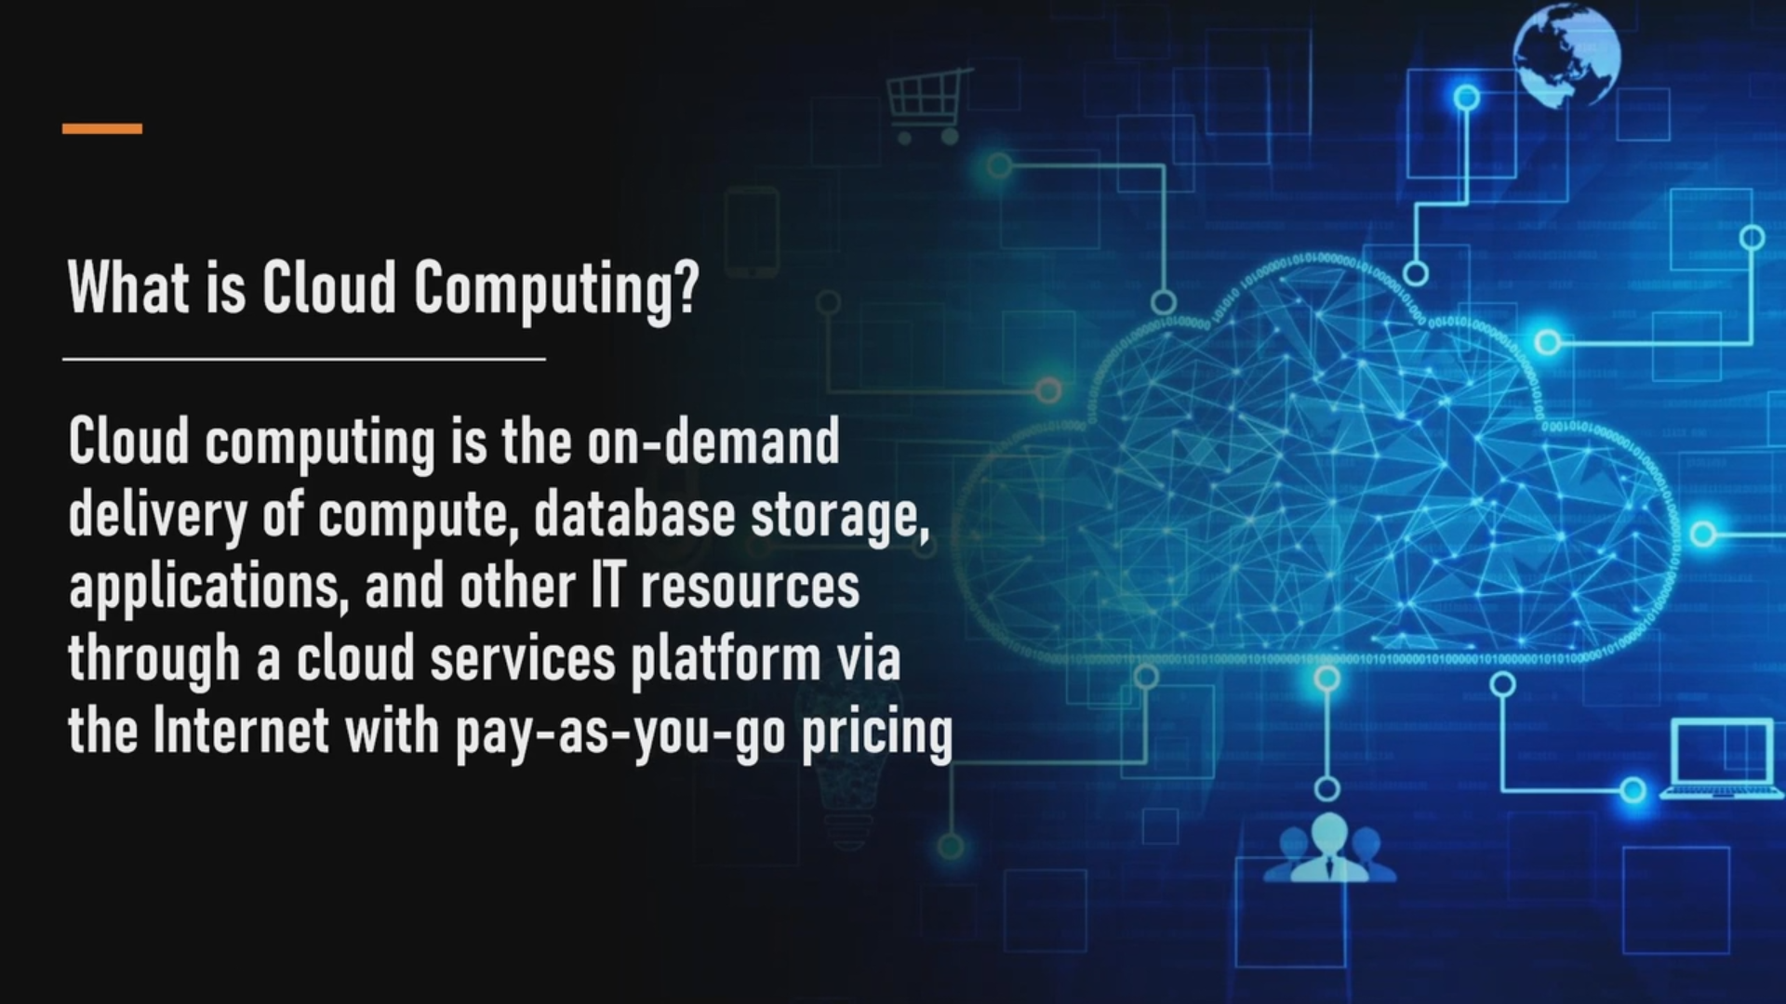


Slide 20
Traditional IT and Cloud Computing

Slide 21
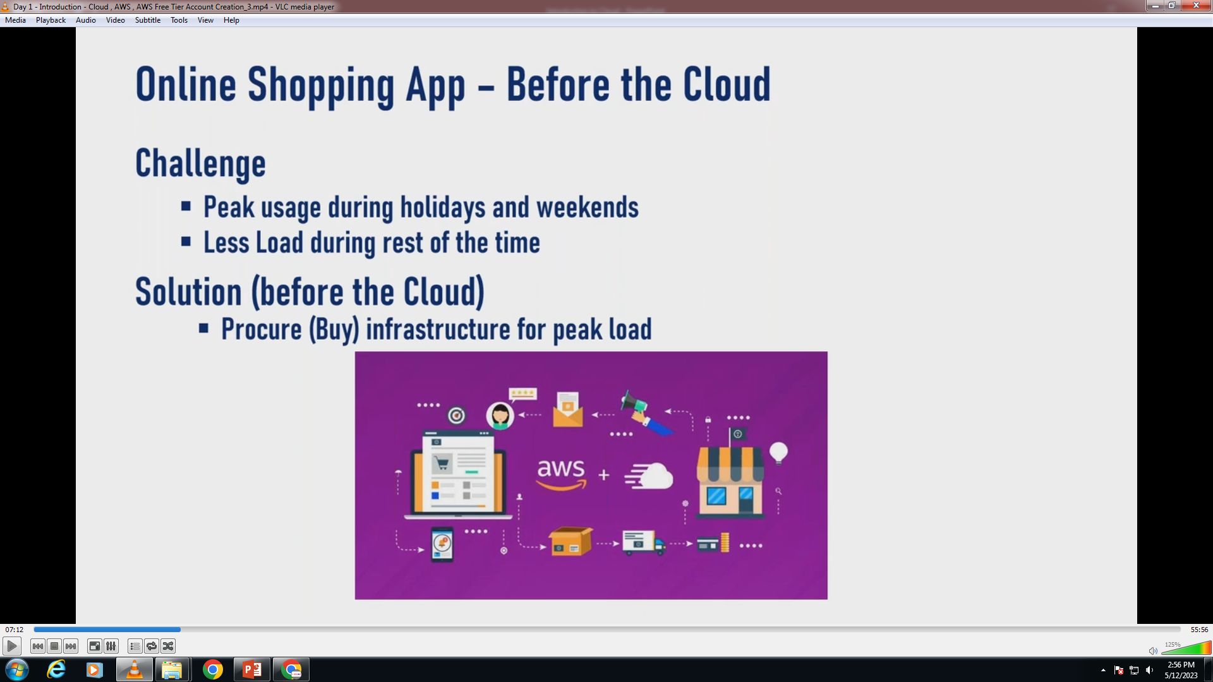
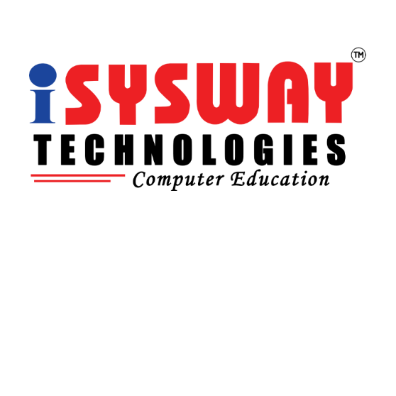

Slide 22
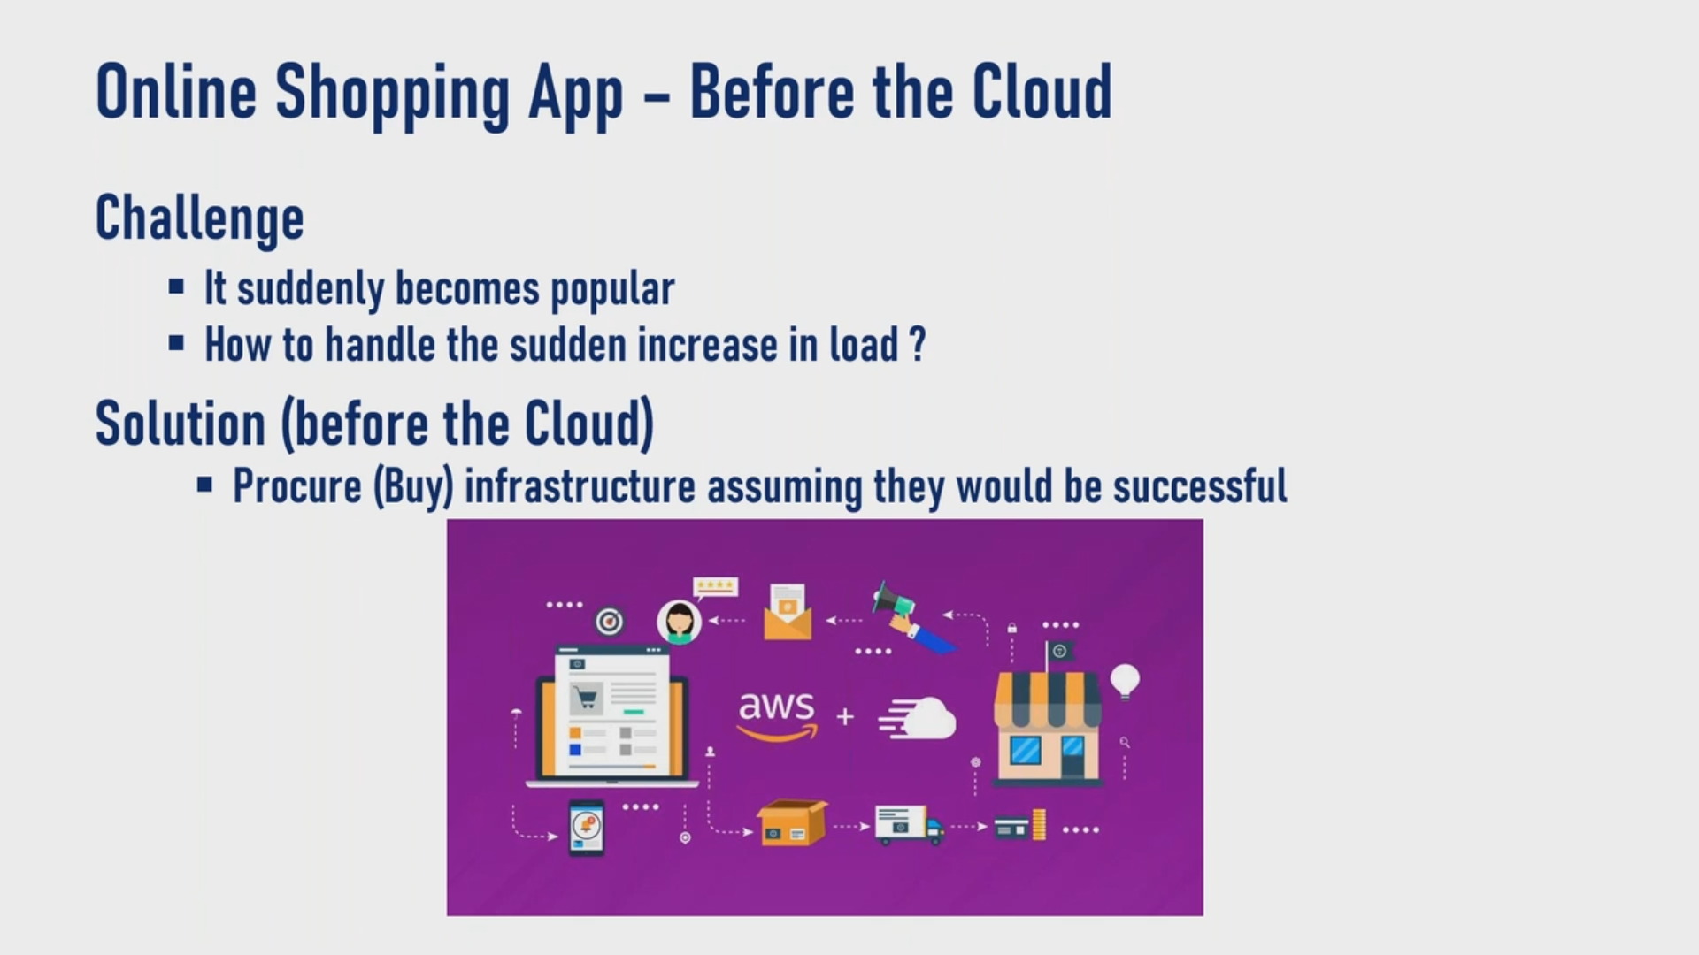


Slide 23
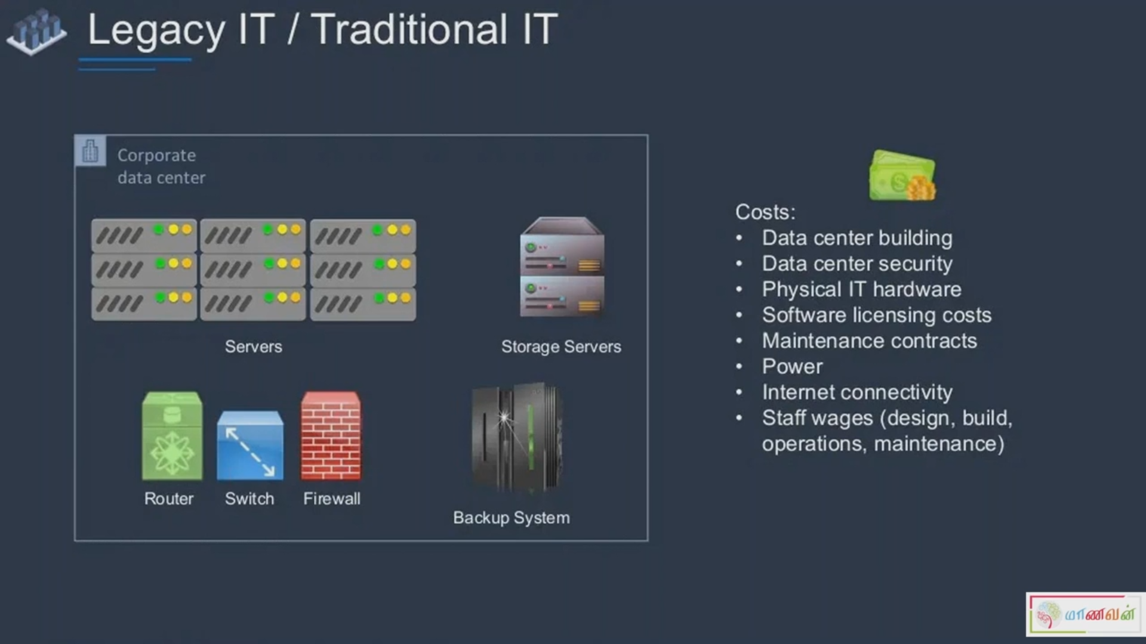


Slide 24
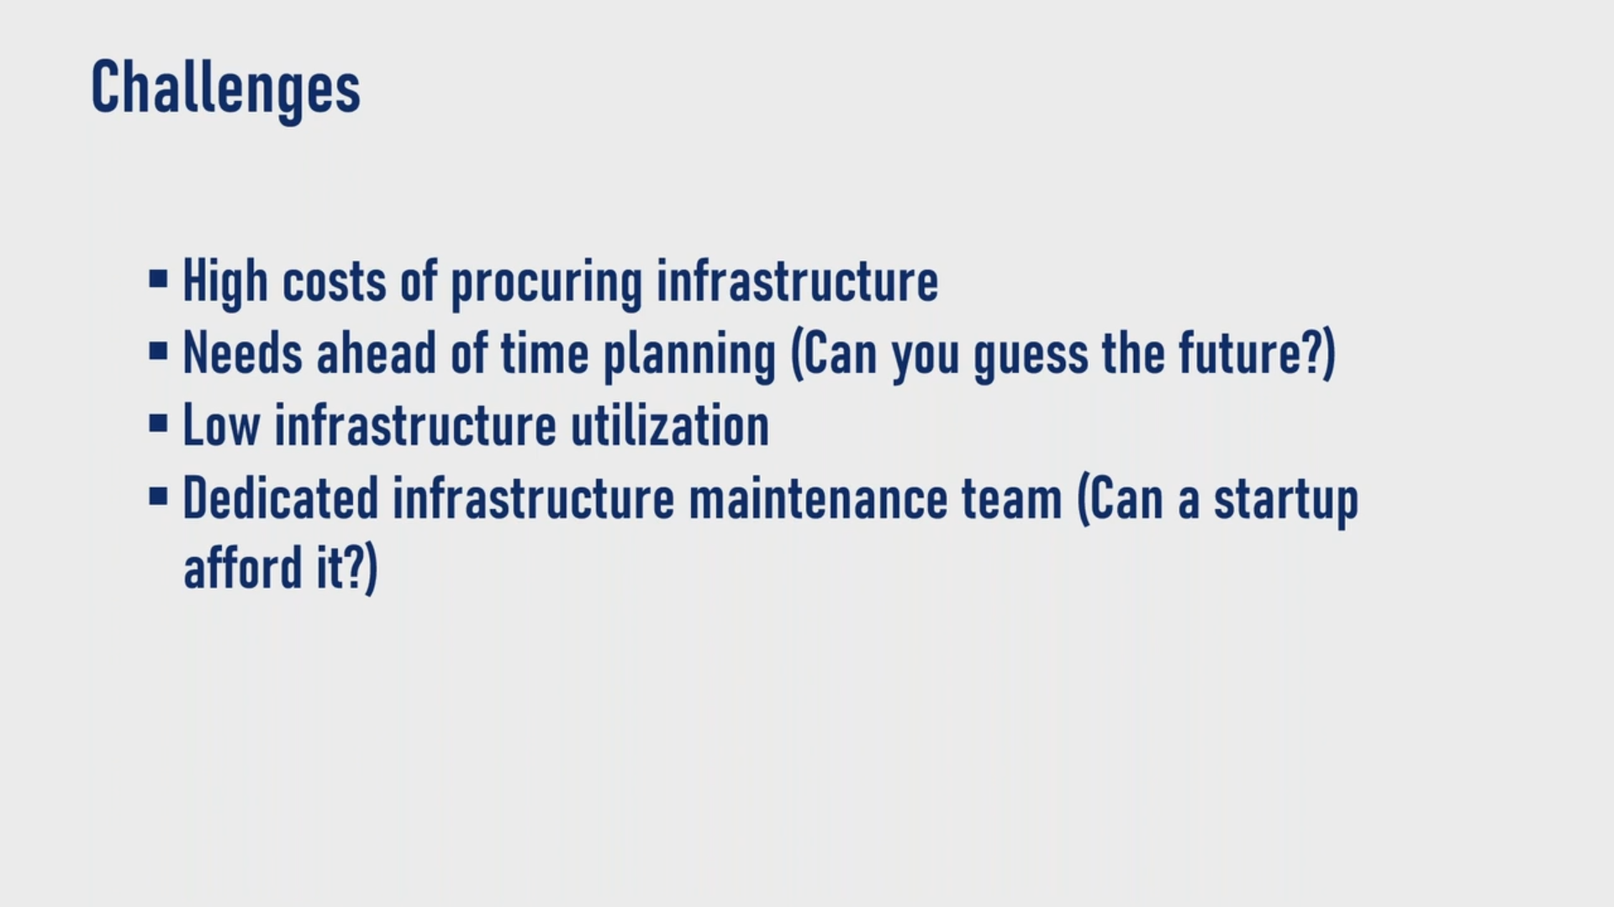


Slide 25
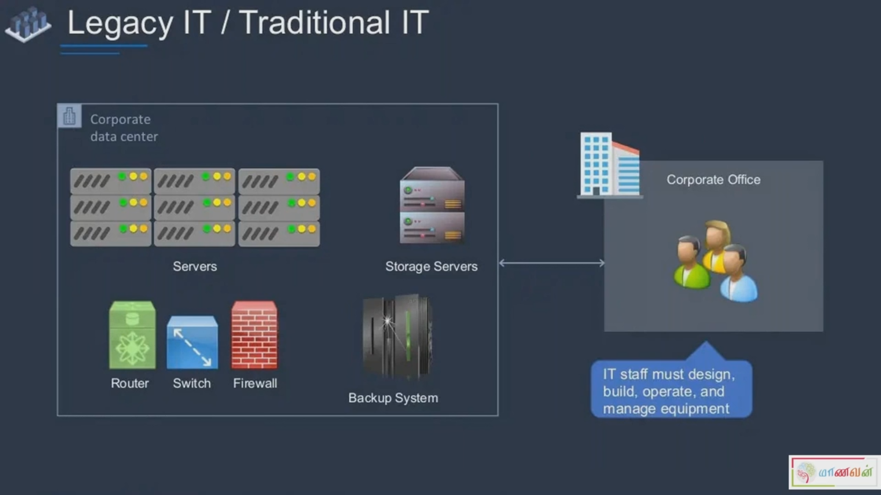


Slide 26
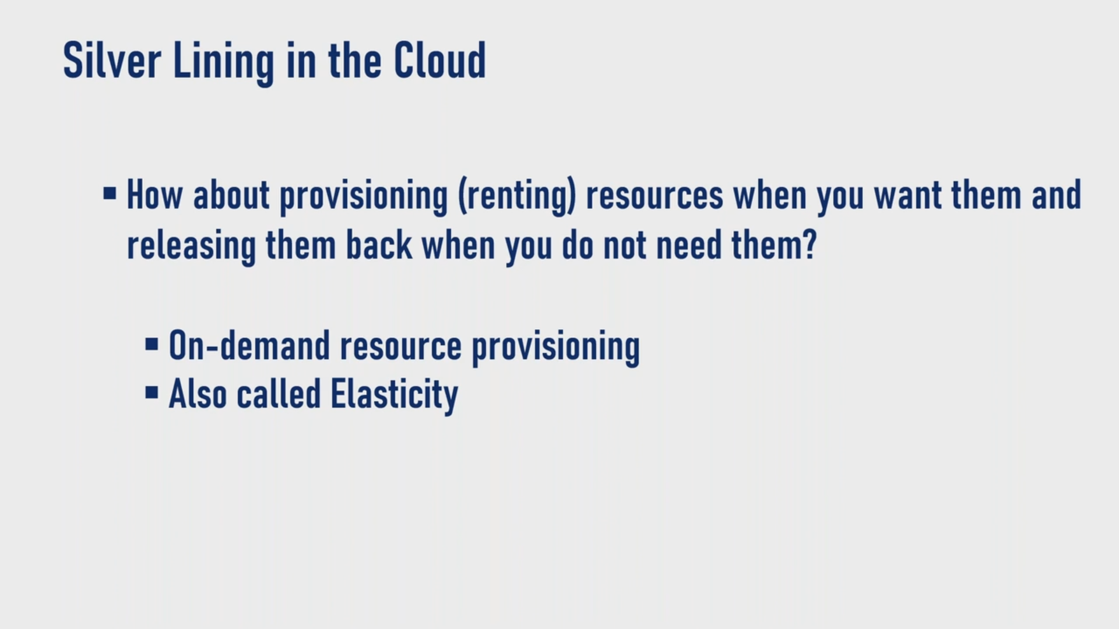


Slide 27
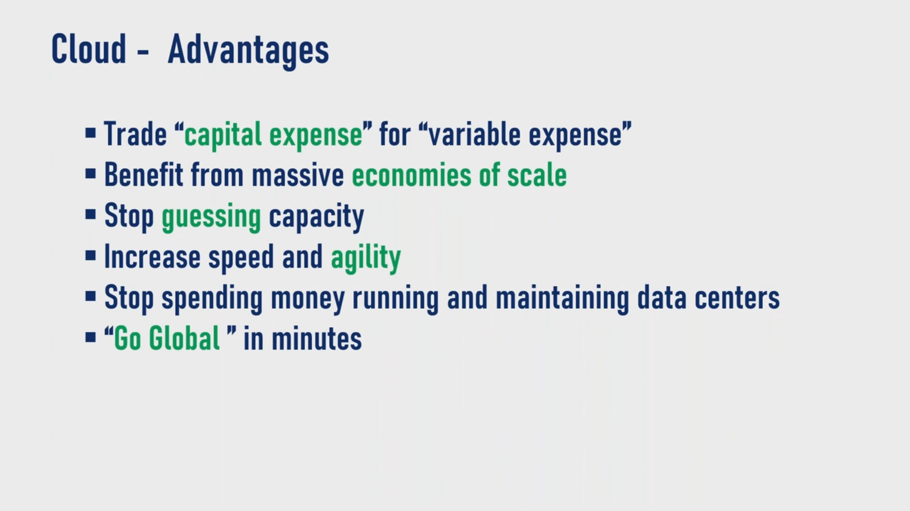


Slide 28
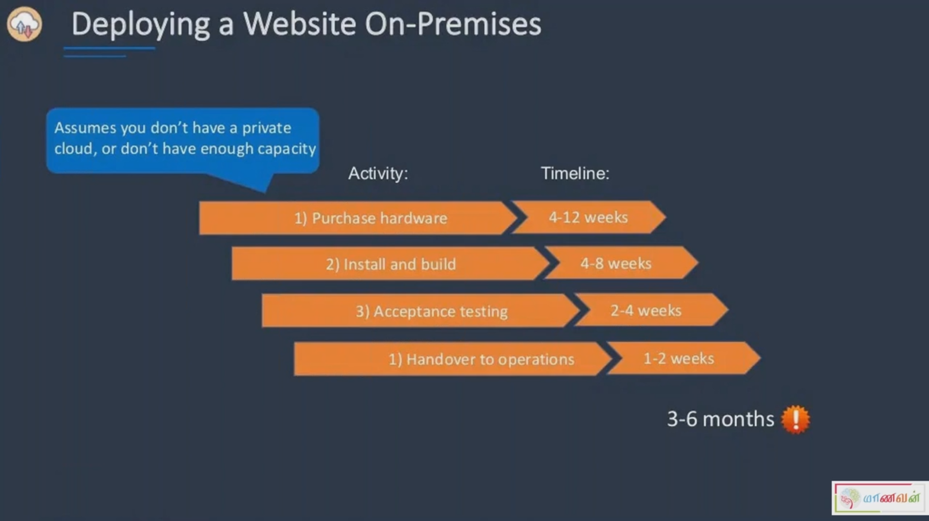


Slide 29
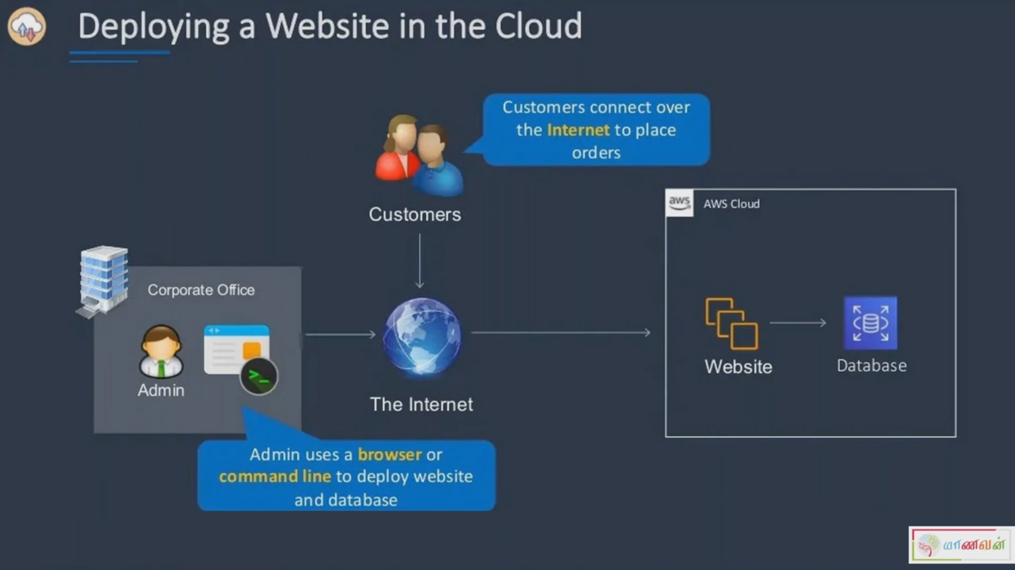
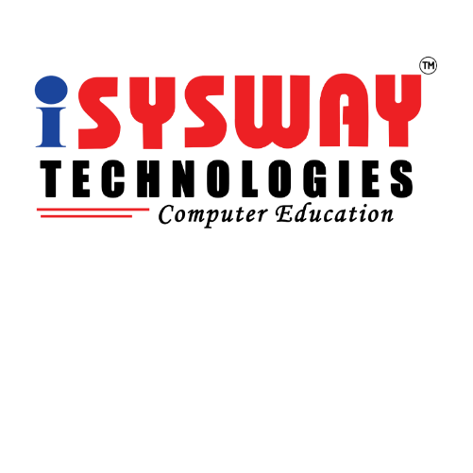

Slide 30
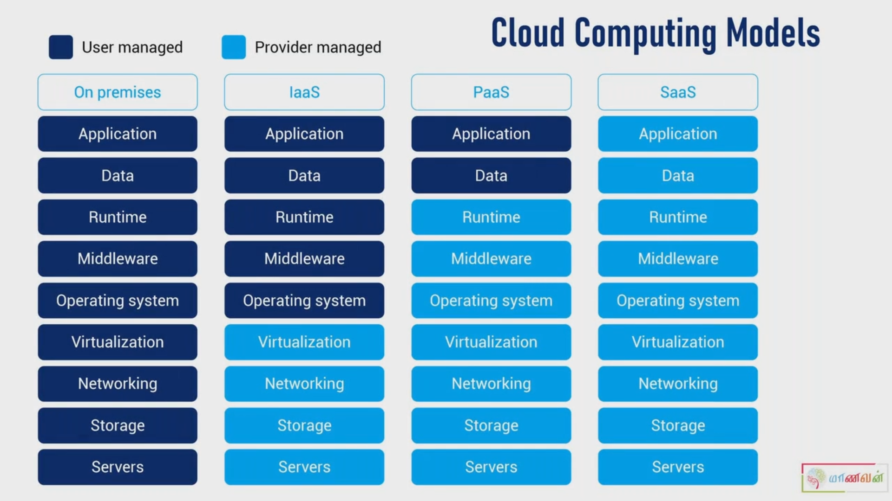
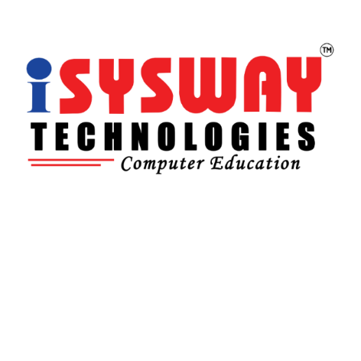

Slide 31
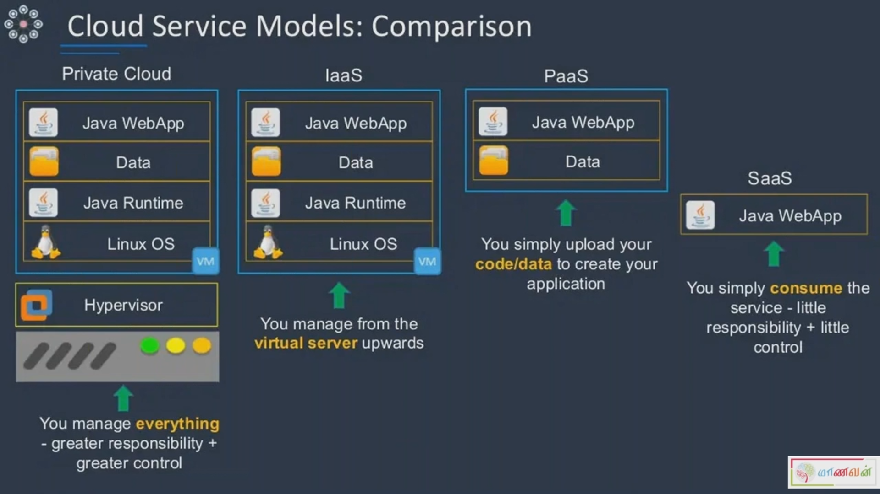


Slide 32
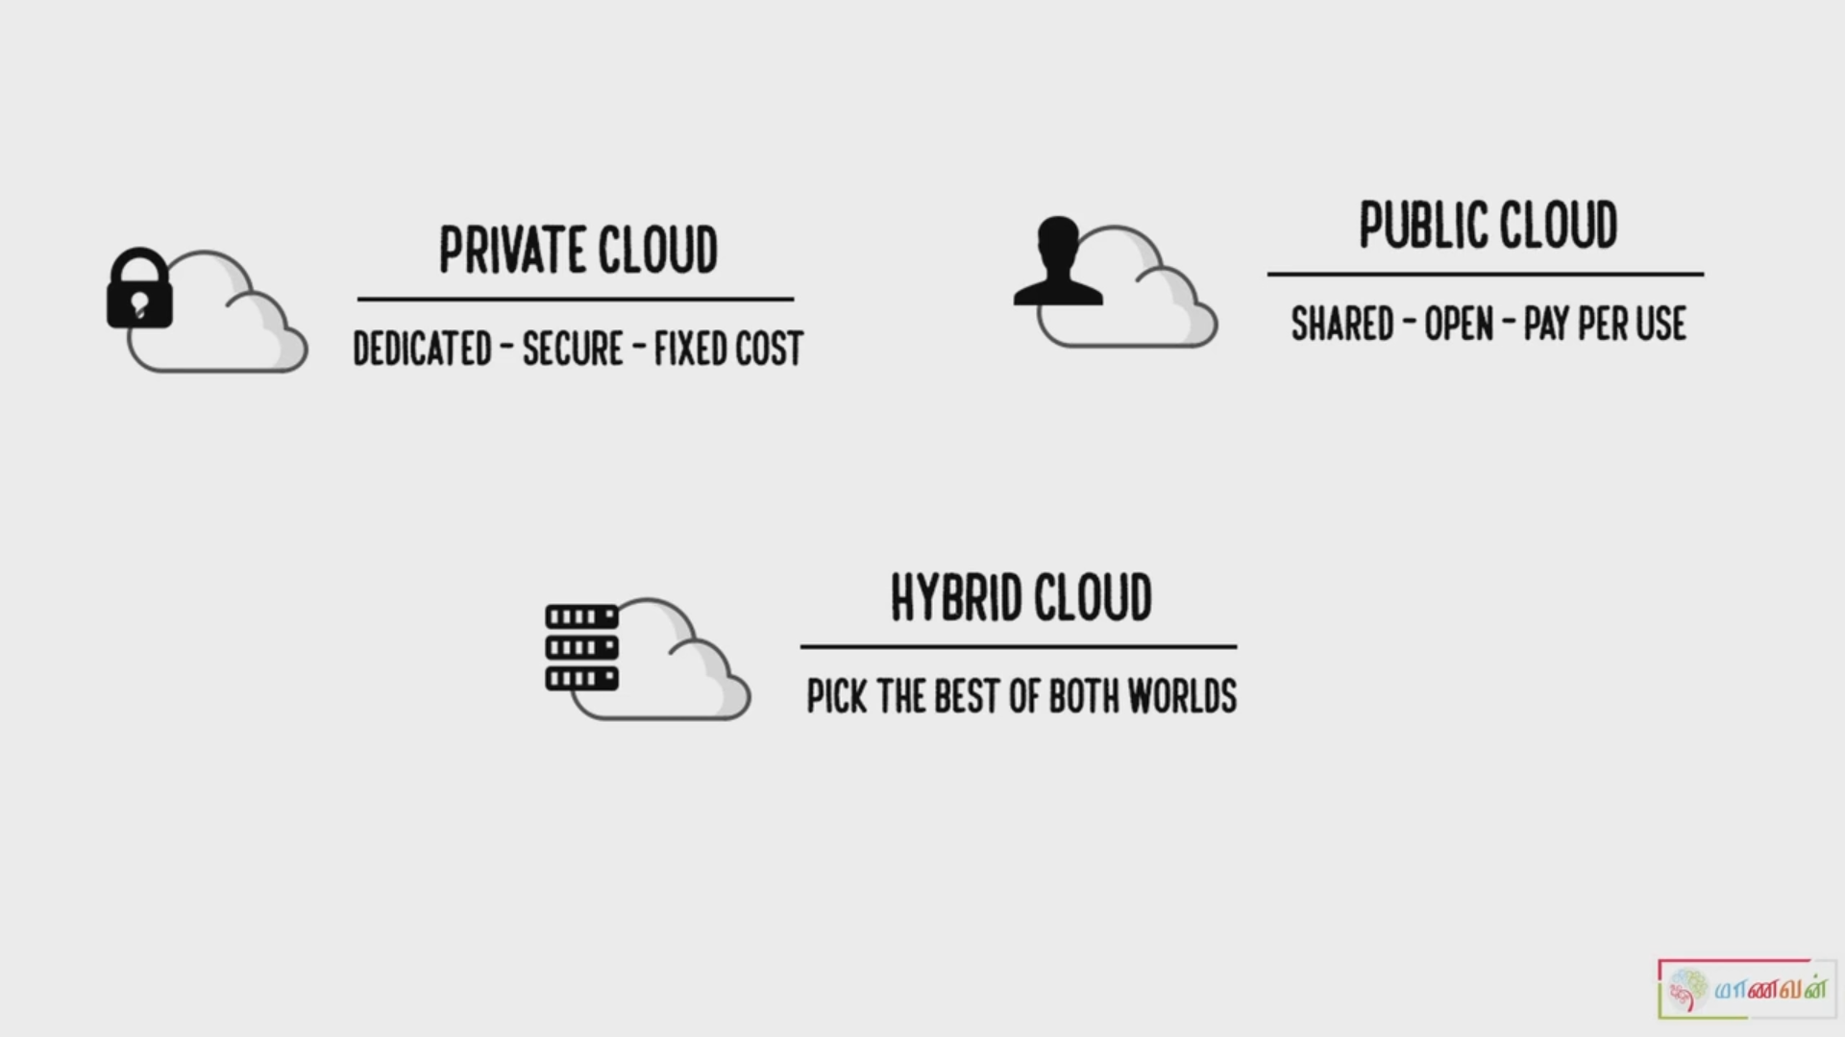


Slide 33
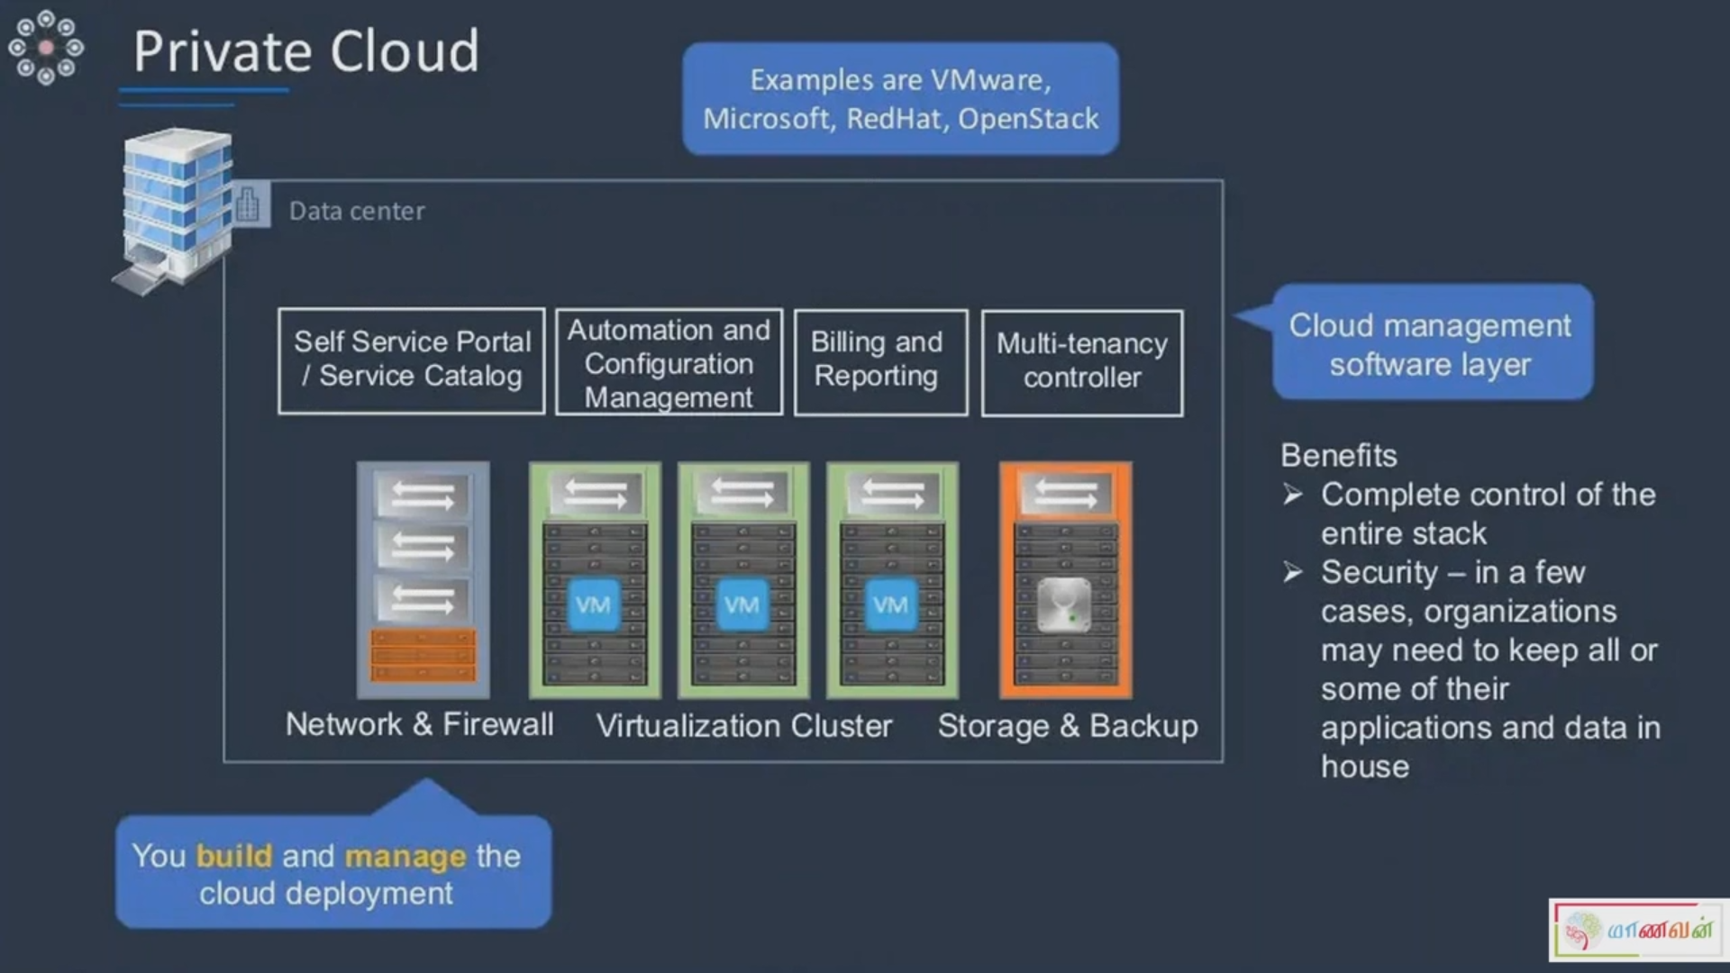


Slide 34
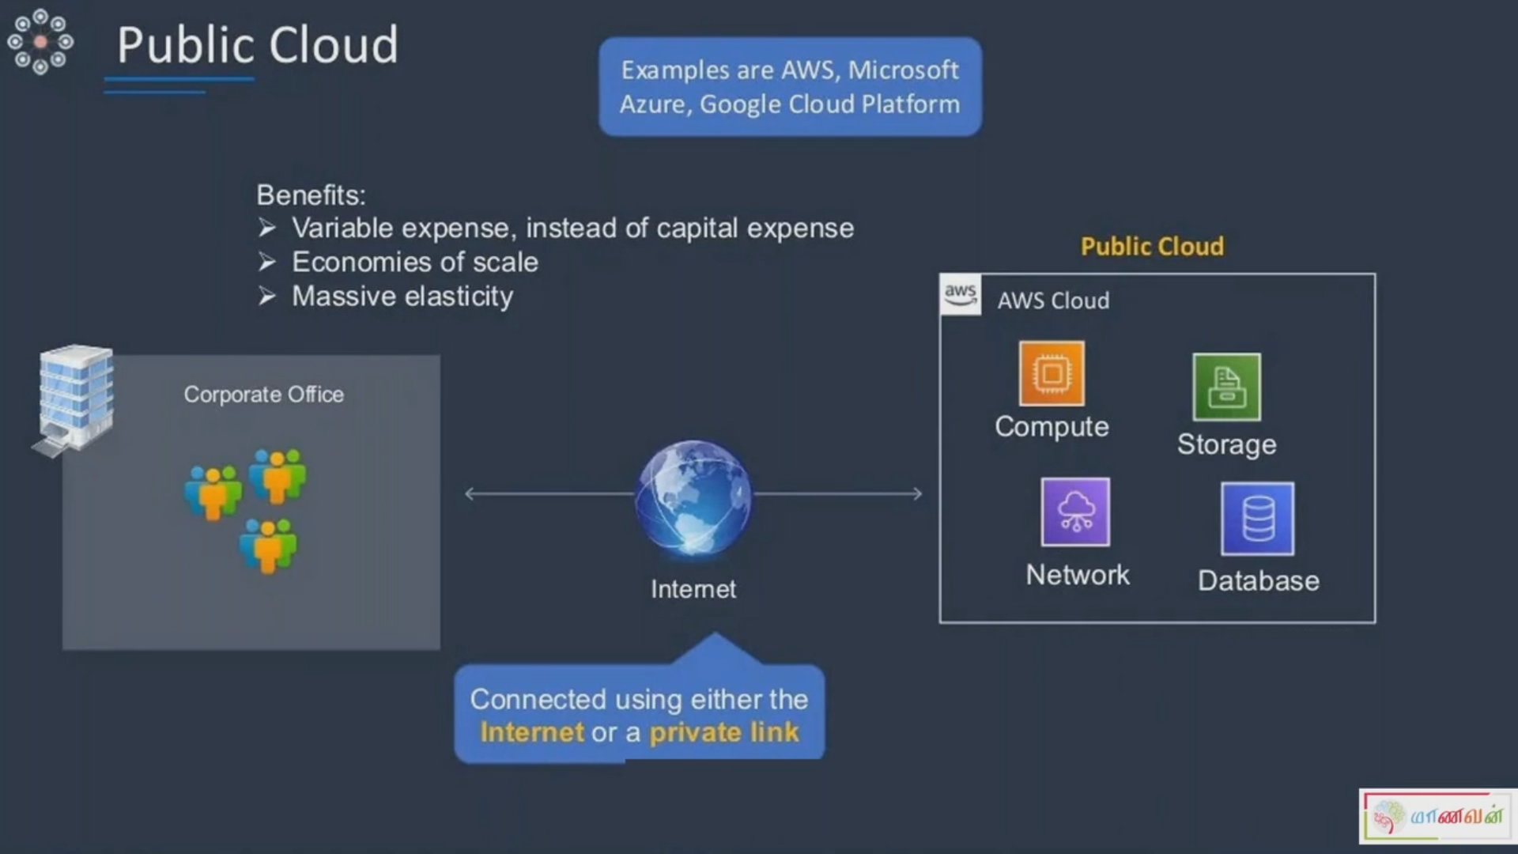


Slide 35
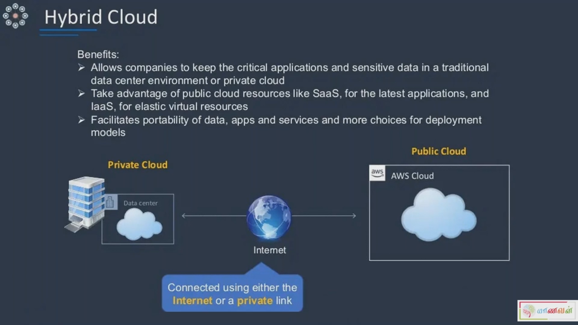

Slide 36
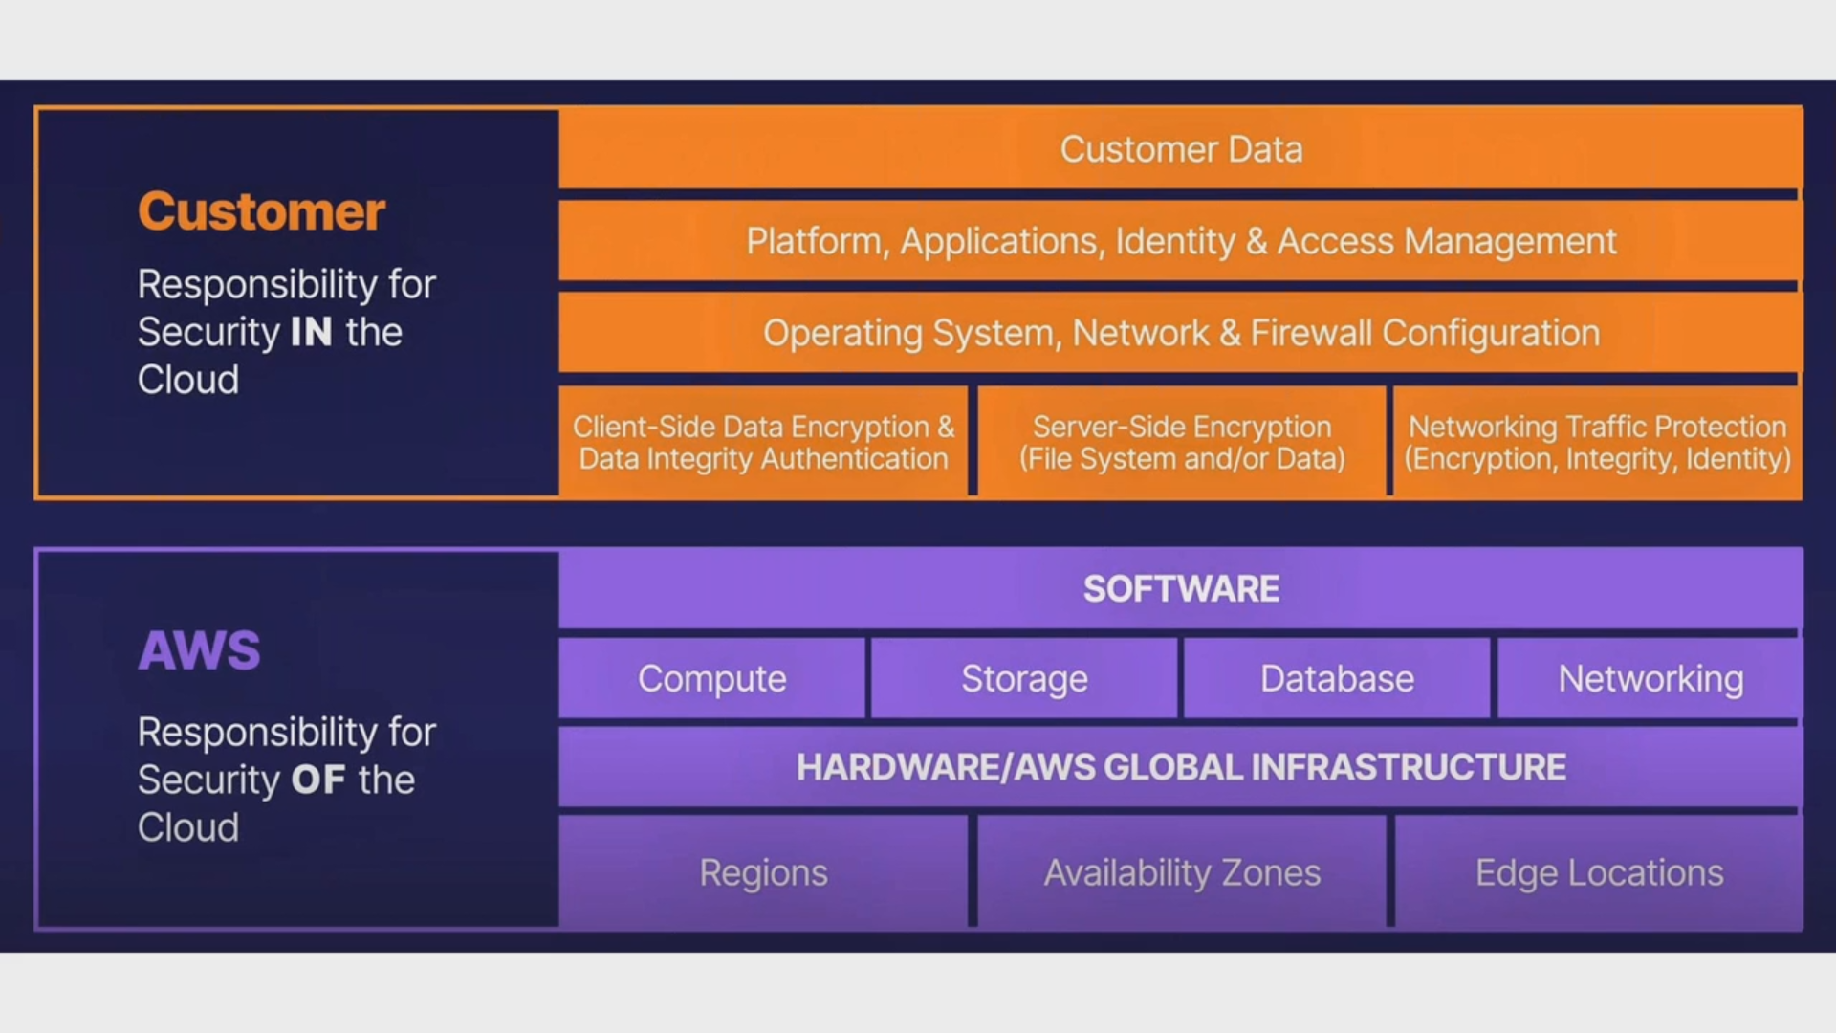
Cloud Platform

Slide 37
AWS (Amazon Web Services)
Amazon Web Services is a comprehensive suite of cloud computing services that lets you create, operate, and manage a variety of applications.
AWS offers a broad range of services that can be used to power your business and help you increase efficiency and improve your scalability.

Slide 38
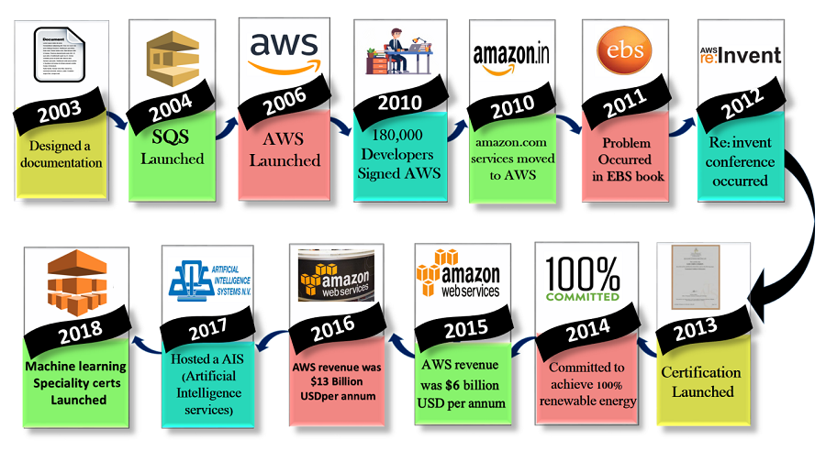

History & Evolution of Aws

Slide 39
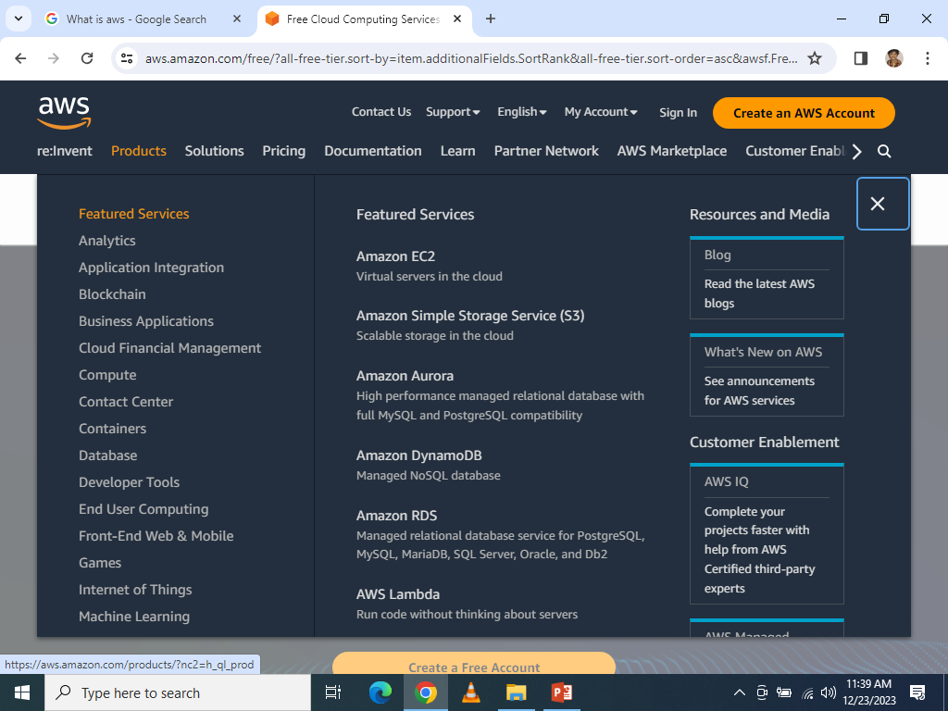
Overview of Products and Services

Slide 40
Global Infrastructure
Overview
Availability Zones
Edge Locations

Slide 41
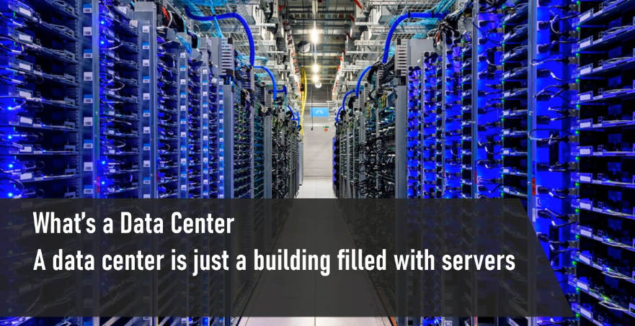
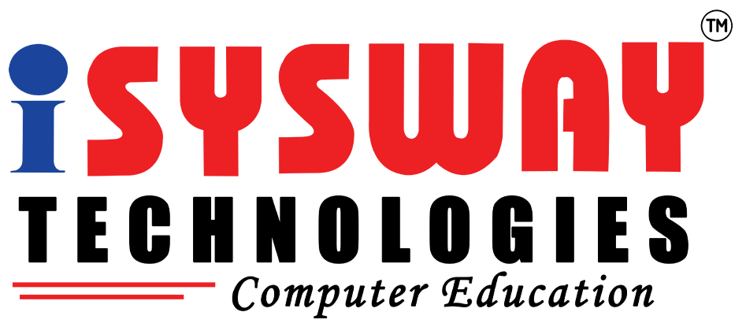

Slide 42
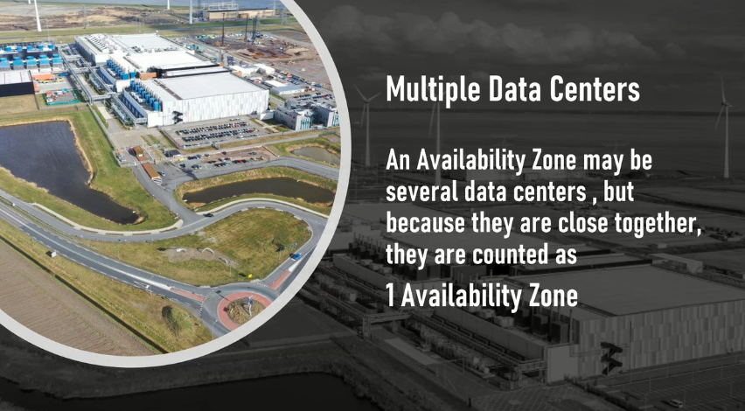

Slide 43
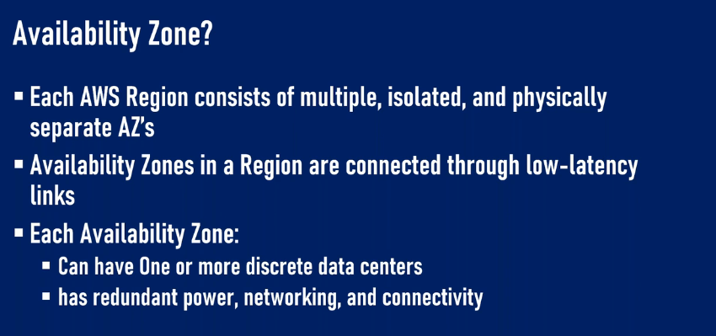

Slide 44
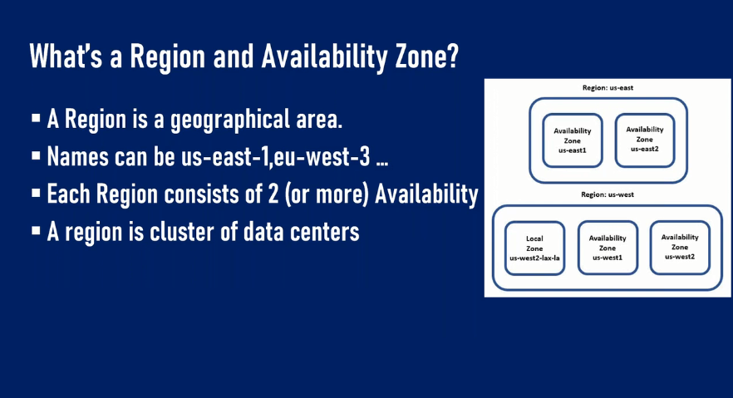

Slide 45
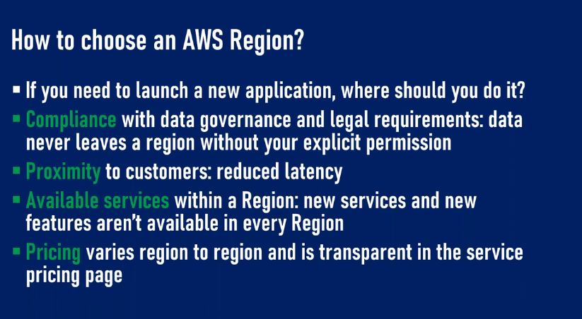

Slide 46
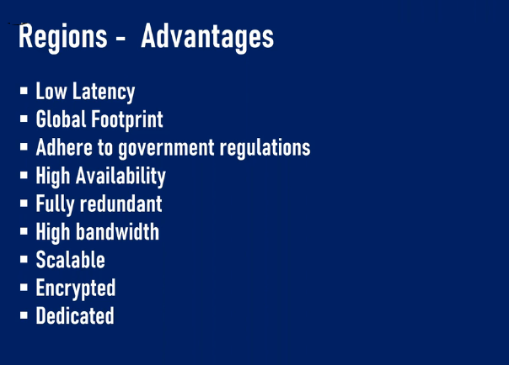

Slide 47
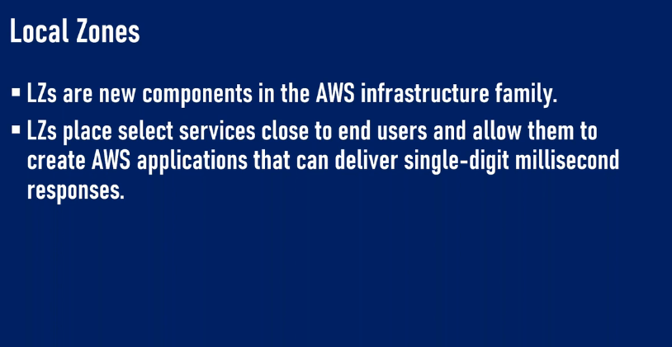

Slide 48
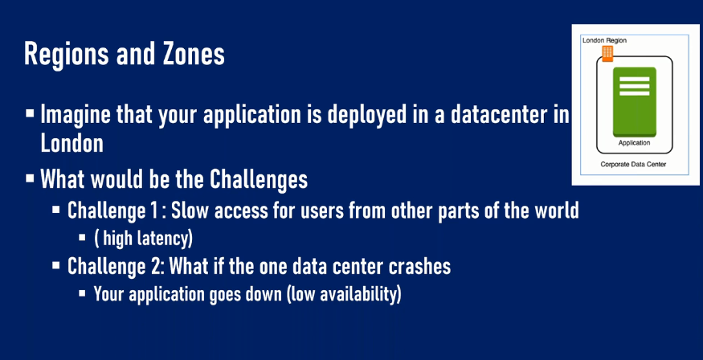

Slide 49
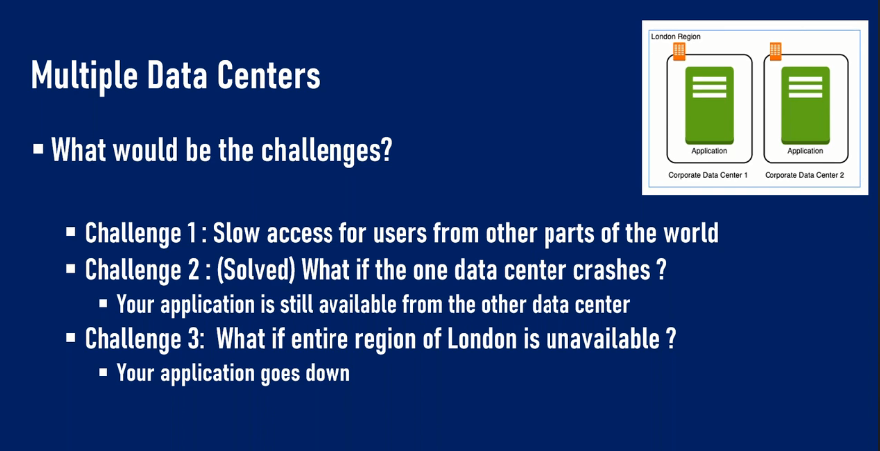

Slide 50
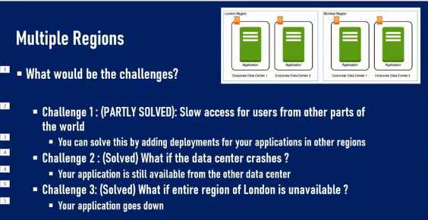

Slide 51
